Slide 1
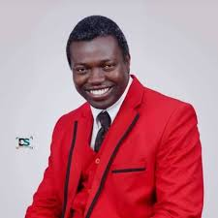
LEADERSHIP & MANAGEMENT
From Position to Influence • From Authority to Service • From Vision to Impact
The Jos Leadership School • Jos, Plateau State, Nigeria
Prof. Pwaveno H. Bamaiyi
www.blessing.ng
“Leadership is not the privilege of being served; it is the responsibility to make others better.”

Slide 2
“
The world does not need more people who merely occupy positions. It needs people who carry responsibility, create hope and leave institutions stronger than they found them.
— Opening challenge

Slide 3
Leadership sets the long-term vision and inspires people, while management builds the structured systems and processes to execute that vision efficiently

Slide 4
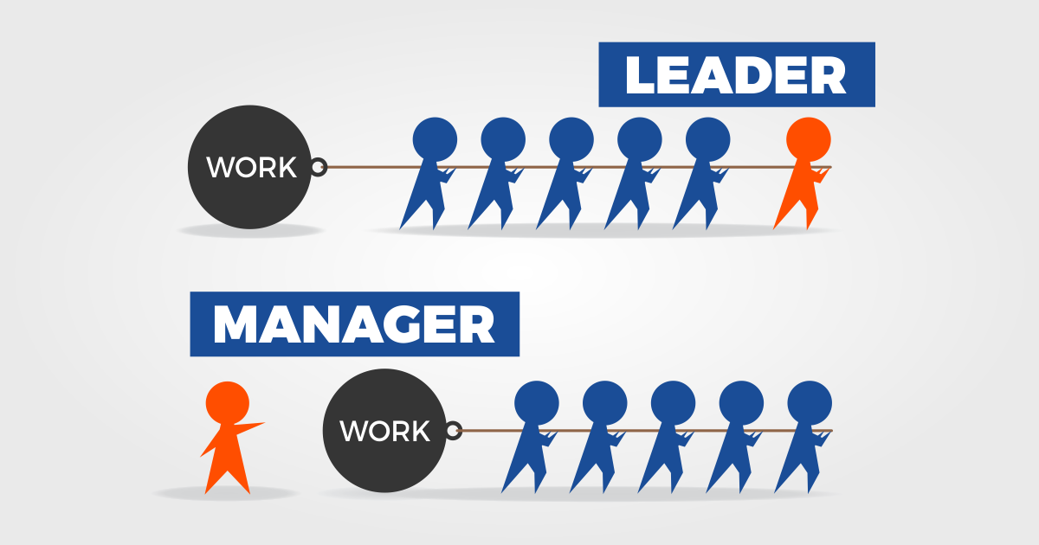

Slide 5
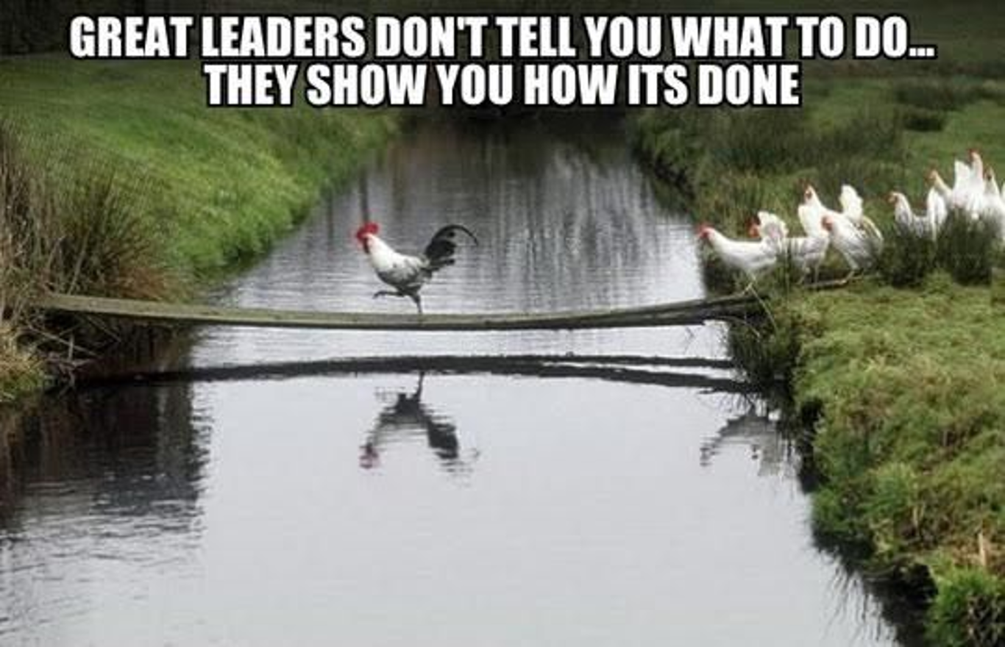

Slide 6
What This Lecture Will Do
Not just knowledge—transformation.
• Redefine leadership beyond title, rank and office.
• Distinguish leadership from management—and show why both are essential.
• Build the habits of ethical, courageous and visionary leadership.
• Translate leadership principles into Nigeria’s institutional and community realities.
• Leave every participant with a personal leadership commitment.

Slide 7
Leadership: The Essence
• Leadership is influence directed toward a worthwhile purpose.
• Leadership begins with self-leadership: character, discipline, values and responsibility.
• A leader sees possibilities before others see them—and helps others see them too.
• Leadership is measured not by how many people obey you, but by how many people become better because of you.

Slide 8
Leadership
Leadership
Service
Empowerment
Purpose
Inspiration
Mentorship

Slide 9
Management: Turning Purpose into Performance
• Management organizes people, resources, processes, time and information to achieve agreed objectives.
• Managers plan, coordinate, budget, delegate, monitor, evaluate and correct.
• Good management creates order; good leadership creates direction.
• Without management, vision can become chaos. Without leadership, efficiency can become emptiness.
Management is the process of working with people and resources to accomplish organisational goals.
Good managers do those things both effectively and efficiently. To be effective is to achieve organisational goals. To be efficient is to achieve goals with minimum waste of resources (money, people, materials and time).

Slide 10
Leadership + Management
Two disciplines. One mission: meaningful results.
LEADERSHIP
MANAGEMENT
• Why?
• Where are we going?
• What matters?
• Who can we become?
• How?
• Who does what?
• When and with what resources?
• How do we measure progress?

Slide 11
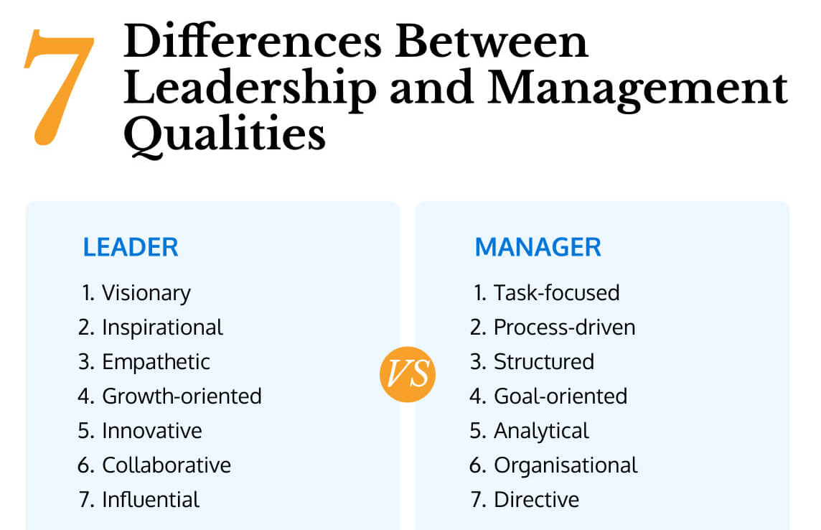

Slide 12
“Management is doing things right; leadership is doing the right things"
— Peter Drucker

Slide 13
1. Lead Yourself Before You Lead Others
• Character before competence. Integrity before influence.
• Master your emotions before you attempt to manage a crisis.
• Keep promises—especially the promises nobody can enforce.
• Build habits of preparation, punctuality, learning, listening and accountability.
• Your private discipline eventually becomes your public reputation.

Slide 14
2. Vision: See Beyond the Present
• Vision answers: What future are we trying to create?
• Great leaders turn distant possibilities into believable next steps.
• Communicate the destination repeatedly—then align people, resources and incentives with it.
• Do not merely inherit systems. Ask whether the system still serves the mission.
• Plateau and Nigeria need leaders who can imagine better—and build better.

Slide 15
“
Where there is no vision, the people perish.
— Proverbs 29:18 (KJV)

Slide 16
3. Leadership Is Service, Not Self-Importance
• Authority is a stewardship, not a personal possession.
• Ask: “What can I do for the people entrusted to me?”
• Servant leadership does not mean weakness—it means using power for the good of others.
• Listen to the quietest voice in the room.
• Leave people with dignity, even when you must correct them.
“Whosoever will be great among you, let him be your minister.” — Matthew 20:26

Slide 17
4. Integrity: The Currency of Trust
• Competence may get you an appointment; character determines whether people trust you.
• Say what you mean. Do what you say. Admit what you do not know.
• Never trade long-term credibility for short-term applause.
• Reject corruption in large and small forms.
• Trust is slow to build, fast to lose, and expensive to rebuild.

Slide 18
5. Courageous Leadership
• Courage is not the absence of fear; it is action in spite of fear.
• Tell the truth respectfully—even when truth is inconvenient.
• Make difficult decisions using principles, evidence and the common good.
• Stand against bullying, discrimination, mediocrity and abuse of office.
• Leadership sometimes means being willing to stand alone before you are joined by others.

Slide 19
6. Emotional Intelligence: People Follow People
• Self-awareness: know your triggers, strengths and blind spots.
• Self-control: do not let anger make decisions your wisdom will later regret.
• Empathy: understand before you judge.
• Social skill: communicate clearly, resolve conflict and build coalitions.
• Never use humiliation as a management strategy.

Slide 20
“
Most people do not listen with the intent to understand; they listen with the intent to reply.
— Stephen R. Covey

Slide 21
7. Delegation: Do Not Build a One-Person Institution
• Delegate outcomes, not merely tasks.
• Match responsibility with authority and resources.
• Set clear expectations, deadlines and measures.
• Allow people to learn—including learning from reasonable mistakes.
• Build successors. If everything collapses when you leave, you did not build an institution; you built dependency.

Slide 22
Process of Delegation
Set the climate for discussion
Describe the task/assignment
Elaborate the reasons for the assignment: Why the person was chosen, linkage to the overall goals, special factors-political, urgency.
Get input and elicit reations
Clarify support, roles, authority, time frame, performance standards and next steps.
Summarise next steps and how you will monitor progress.

Slide 23
8. Decision-Making Under Pressure
• Define the real problem—not just the loudest symptom.
• Separate facts, assumptions, opinions and emotions.
• Ask: What is legal? What is ethical? What is wise? What serves the mission?
• Consult widely, decide clearly, communicate promptly.
• Once a decision is made, own the consequences and learn from the outcome.

Slide 24
9. Conflict: Convert Friction into Progress
• Conflict is inevitable; destructive conflict is not.
• Attack the problem—not the person.
• Address issues early, privately and fairly.
• Seek common ground without compromising principle.
• After resolution, restore working relationships whenever possible.

Slide 25
10. Innovation: Leadership for a Changing World
• Yesterday’s methods cannot automatically solve tomorrow’s problems.
• Reward curiosity, experimentation and evidence-based improvement.
• Use technology—including AI—without surrendering human judgment, ethics or accountability.
• Ask every team: What should we stop? What should we start? What should we improve?
• Innovation is not novelty; it is better value created responsibly.

Slide 26
Leadership in Nigeria: The Assignment Before Us
• Build institutions that outlive individuals.
• Replace entitlement with responsibility; blame with problem-solving.
• Promote merit, fairness, competence and accountability.
• Invest in young people—not merely as followers, but as future decision-makers.
• Choose nation-building over sectionalism, personal gain and short-term politics.
• Let leadership begin wherever you have influence: family, classroom, workplace, community, profession and nation.
Stop the lamentation and initiate action

Slide 27
A Leadership Challenge for Jos & Plateau
• Jos has a long tradition of education, enterprise, public service and cultural diversity.
• Leadership must turn diversity from a source of suspicion into a source of strength.
• Build bridges across professional, ethnic, religious and generational boundaries.
• Let competence, character and service become the common language of public life.
• Be leaders who make Plateau safer, fairer, more productive and more hopeful.

Slide 28
The Ethical Leader’s Test
• Would I make the same decision if it were published tomorrow?
• Would I advise my child, student or protégé to do the same thing?
• Who bears the cost of my decision?
• Am I protecting the institution—or protecting myself?
• Is this merely permissible, or is it genuinely right?

Slide 29
A Simple Leadership–Management Dashboard
• VISION — Is everyone clear about where we are going?
• PEOPLE — Are the right people empowered and developed?
• RESOURCES — Are money, time and assets aligned with priorities?
• EXECUTION — Are plans becoming measurable results?
• TRUST — Do people believe our words and decisions?: “The tight rope walker”
• IMPACT — What has improved because we were here?

Slide 30
Seven Habits of Leaders People Remember
• Listen before speaking.
• Prepare before deciding.
• Serve before demanding.
• Tell the truth before defending yourself.
• Develop people before displaying yourself.
• Measure outcomes before celebrating activity.
• Leave every place better than you found it.

Slide 31
“
A leader’s greatest monument is not the office they occupied, but the people and institutions they strengthened.
— Leadership principle

Slide 32
The 5-Minute Leadership Audit
Write the answers. Be brutally honest.
• What is my greatest leadership strength?
• What is my most dangerous leadership weakness?
• Who is becoming better because of my influence?
• What difficult conversation am I avoiding?
• What one change will I make in the next 7 days?

Slide 33
Your Leadership Action Plan
• NEXT 24 HOURS — Clarify one priority and one promise.
• NEXT 7 DAYS — Have one courageous conversation and encourage one person.
• NEXT 30 DAYS — Improve one process and develop one emerging leader.
• NEXT 60 DAYS — Measure a meaningful outcome and correct course.
• NEXT 90 DAYS — Leave a visible improvement that can continue without you.

Slide 34
Leadership as Stewardship
• “Moreover it is required in stewards, that a man be found faithful.” — 1 Corinthians 4:2
• “Let nothing be done through strife or vainglory; but in lowliness of mind let each esteem other better than themselves.” — Philippians 2:3
• “And whatsoever ye do, do it heartily, as to the Lord.” — Colossians 3:23
• Leadership is ultimately a trust: of people, resources, opportunities and influence.

Slide 35
“
The question is not, “How important am I?” The better question is, “How much good can flow through my leadership?”
— The leadership question

Slide 36
THE FINAL CHARGE
Do not wait for a title.
Do not wait for permission.
Do not wait for perfect conditions.
START WHERE YOU ARE.
SERVE WHO YOU CAN.
SOLVE WHAT YOU CAN.
BUILD WHO COMES AFTER YOU.

Slide 37
ONE DAY, YOUR TITLE WILL BE FORGOTTEN.
BUT THE PEOPLE YOU LIFTED,
THE INSTITUTIONS YOU STRENGTHENED,
THE PROBLEMS YOU SOLVED,
AND THE HOPE YOU CREATED
CAN OUTLIVE YOU.
That is leadership. That is legacy.
Prof. Pwaveno H. Bamaiyi

Slide 38
Lead with vision.
Manage with excellence.
Serve with humility.
Stand with courage.
Finish with integrity.
The Jos Leadership School • Jos, Plateau State, Nigeria
Prof. Pwaveno H. Bamaiyi

Slide 39


