Slide 1
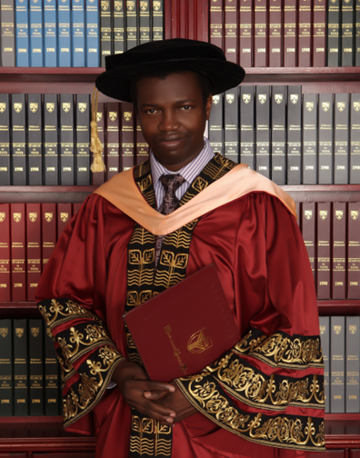

DO WHATEVER HE TELLS YOU John 2:5
Prof. Pwaveno H. Bamaiyi
Dean
Faculty of Veterinary Medicine
University of Jos
H/P: 09035794545

Slide 2
His mother said to the servants, “Do whatever he tells you” John 2:5 (NIV)

Slide 3
DO AND WHATEVER
Do: Action Acts 1:1
Whatever: nothing is exempted

Slide 4
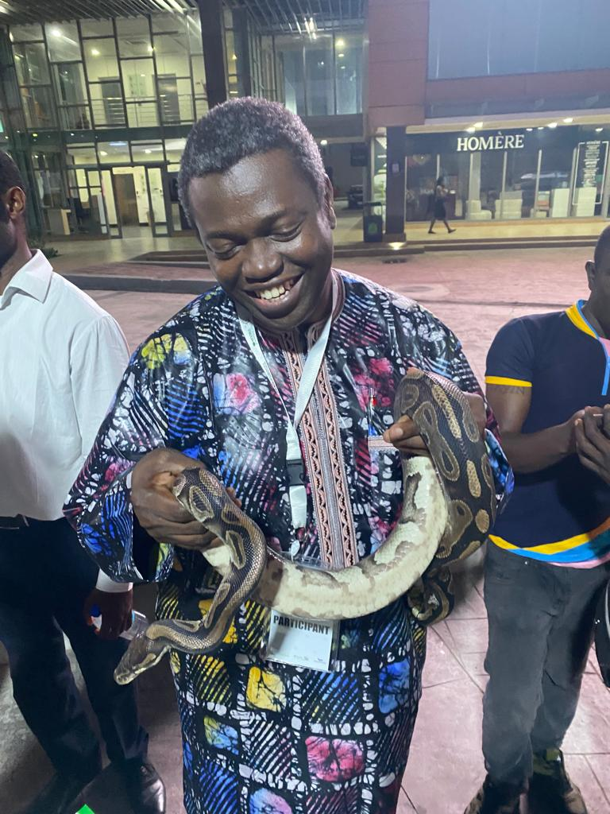
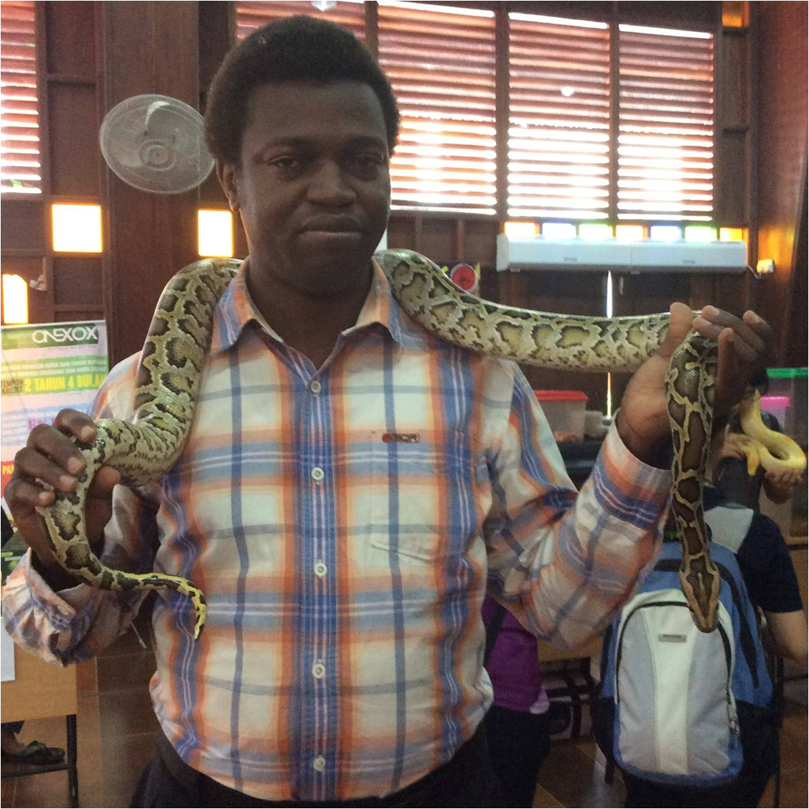

Slide 5
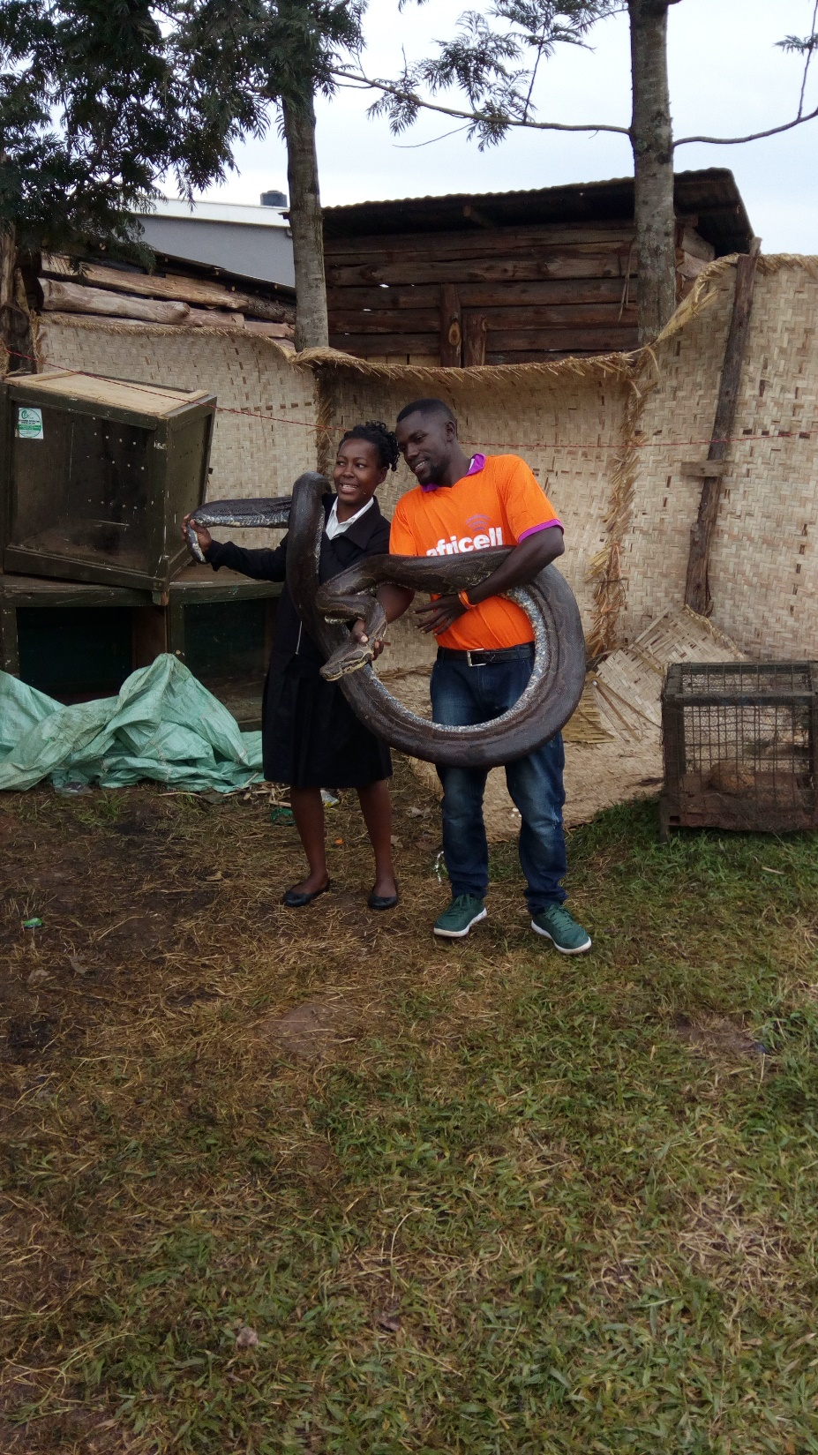

Slide 6
Those who disobey God…

Slide 7


Slide 8
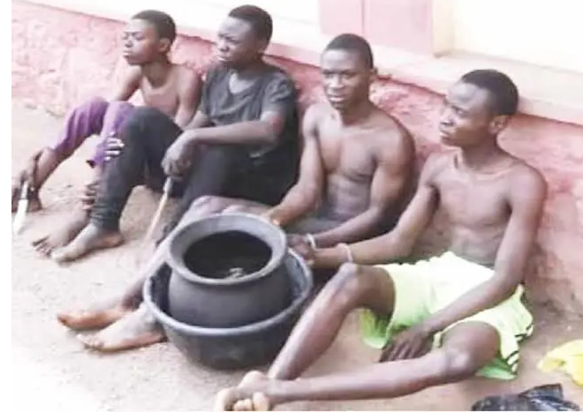
Balogun Mustakeem, Majekodunmi Soliudeen, Abdulgafa Lukman and Waris Oladeinde 28th January, 2022

Slide 9


Slide 10
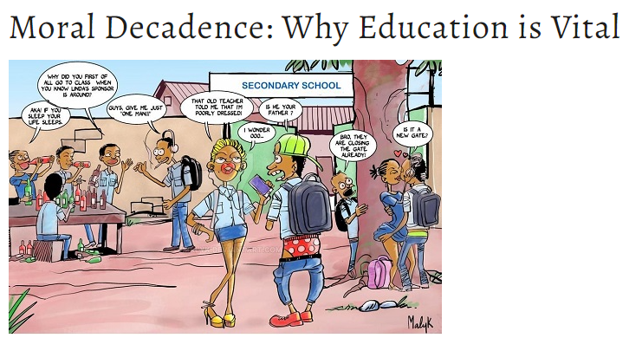

Slide 11
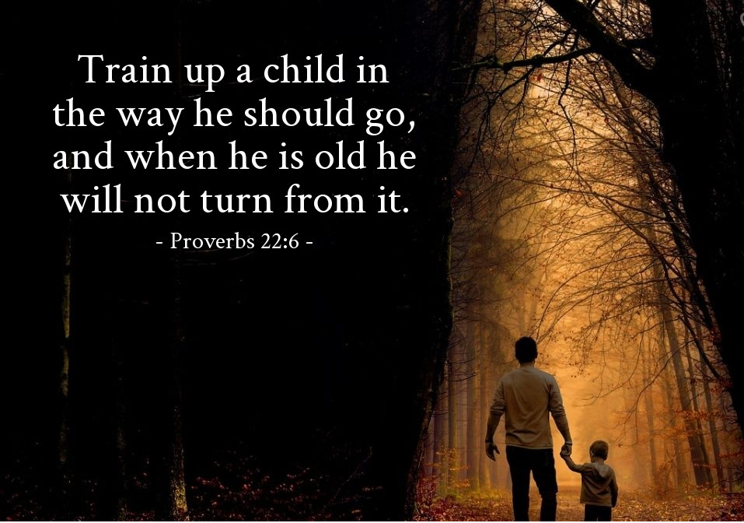

Slide 12
What is He telling us to do?

Slide 13
“IN TIMES LIKE THESE”

Slide 14
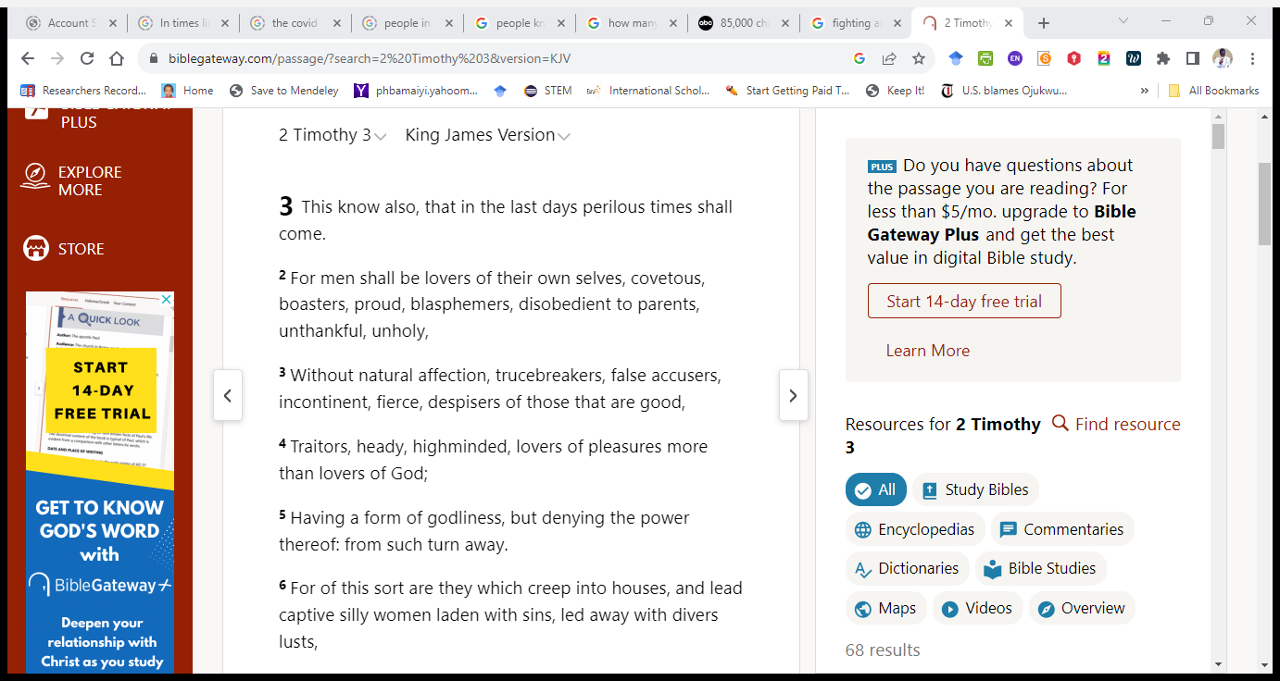

Slide 15
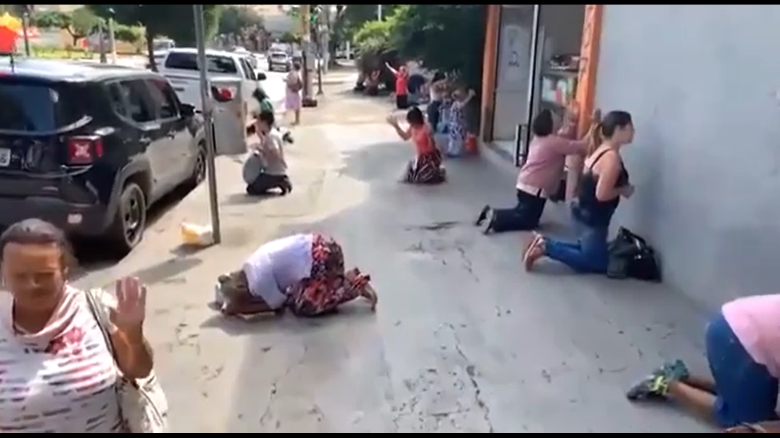

Slide 16
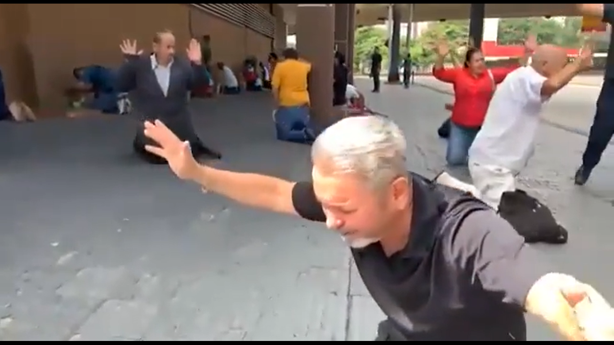

Slide 17
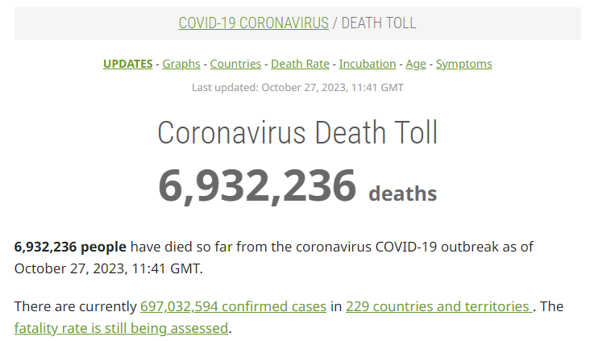

Slide 18
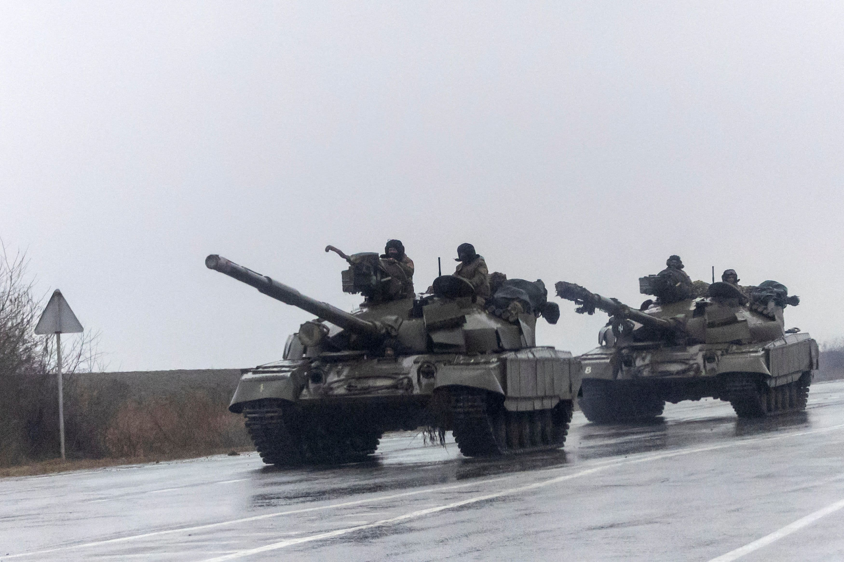

Slide 19
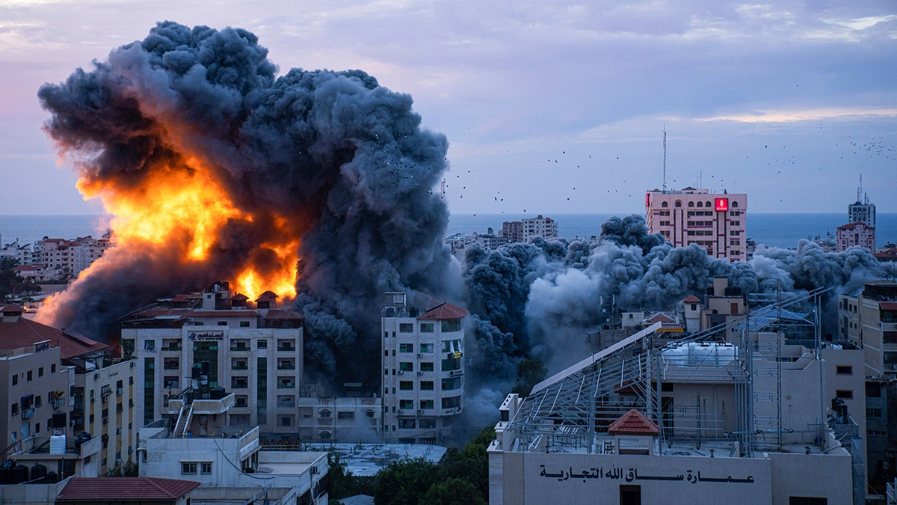

Slide 20
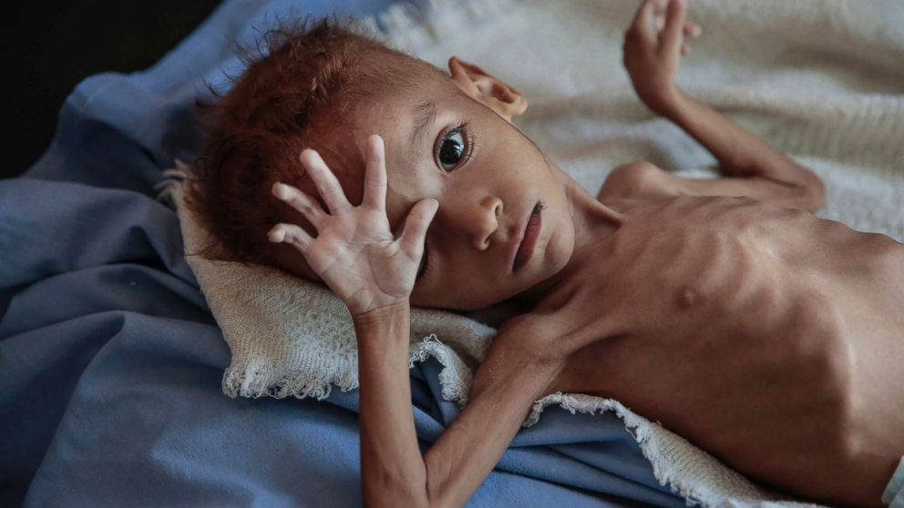
15 Million children die of hunger and starvation yearly and 40,000 die everyday of hunger-related causes

Slide 21
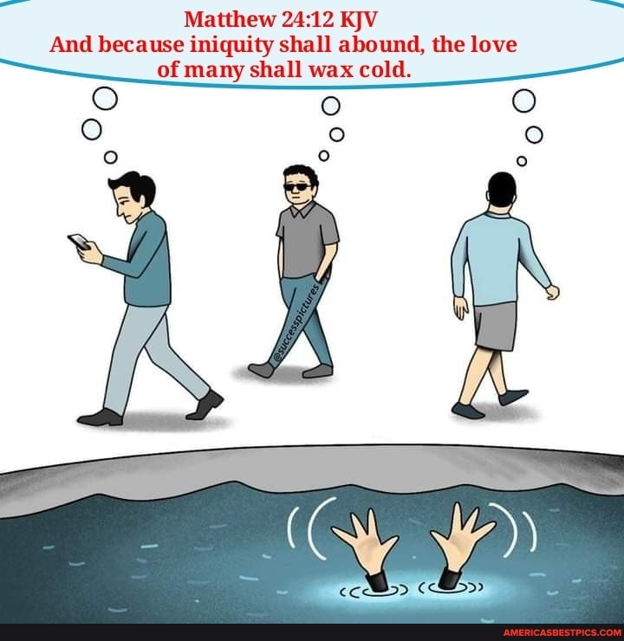

Slide 22


Slide 23
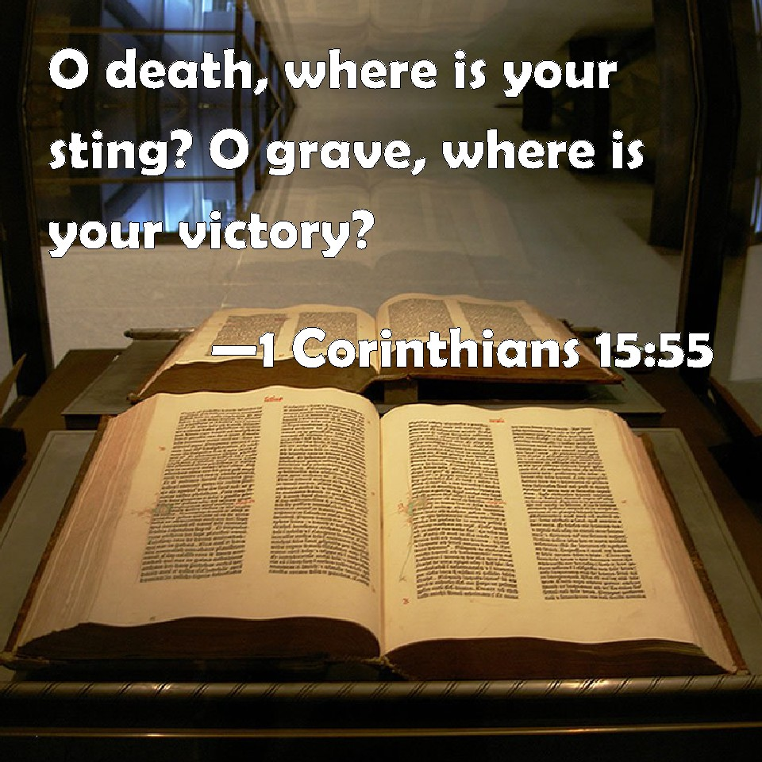

Slide 24
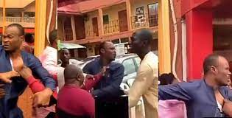

Slide 25

What should we do in Times Like These?

Slide 26
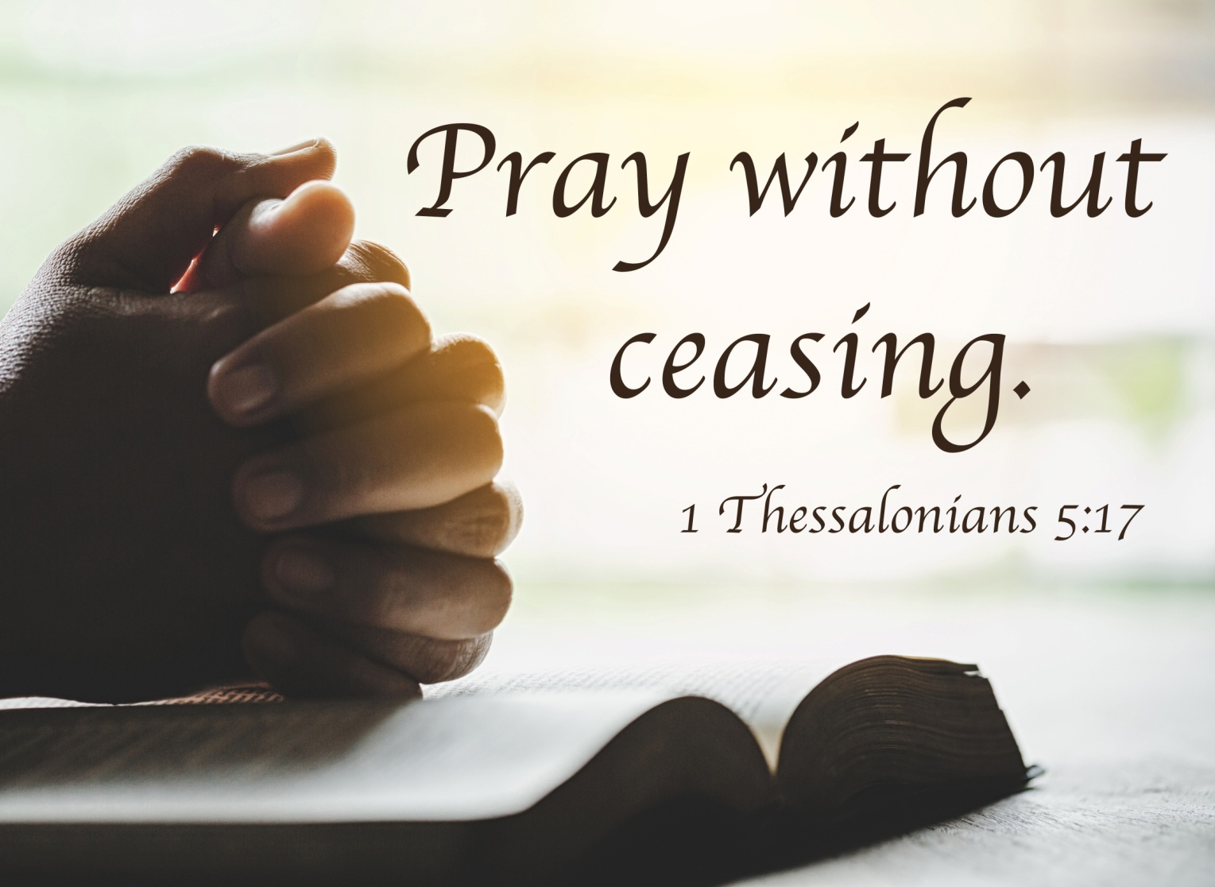
Pray without Ceasing

Slide 27

Love without Ceasing

Slide 28
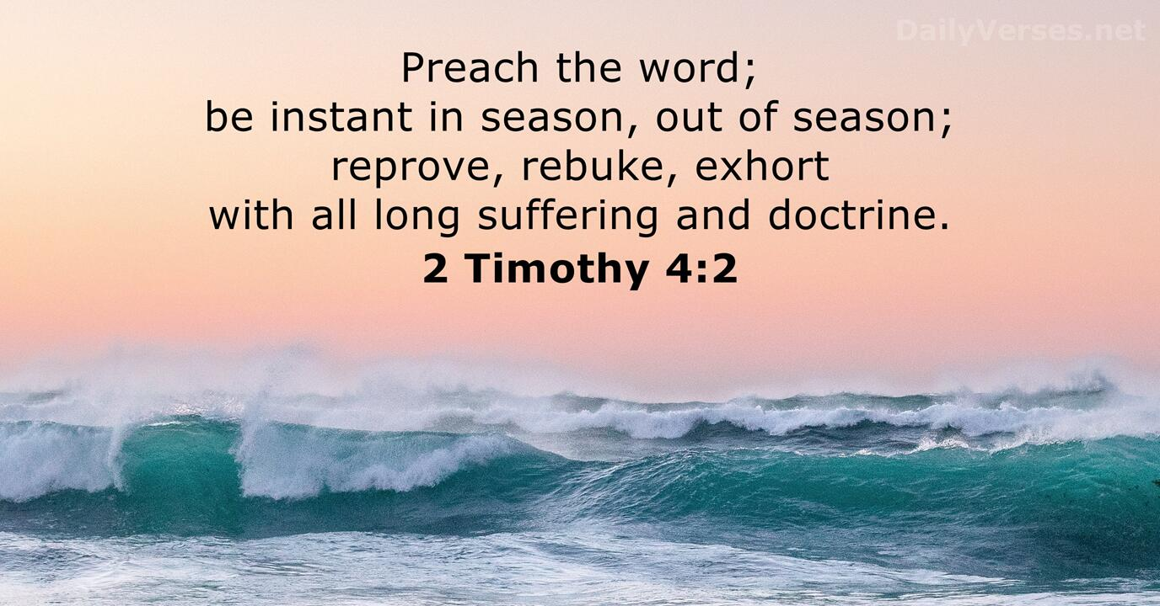
Witness without Ceasing

Slide 29

Holiness without Ceasing

Slide 30

Testify without Ceasing

Slide 31
Faith without Ceasing
Luke 18:8
I say unto you, that he will avenge them speedily. Nevertheless, when the Son of man cometh, shall he find faith on the earth?

Slide 32
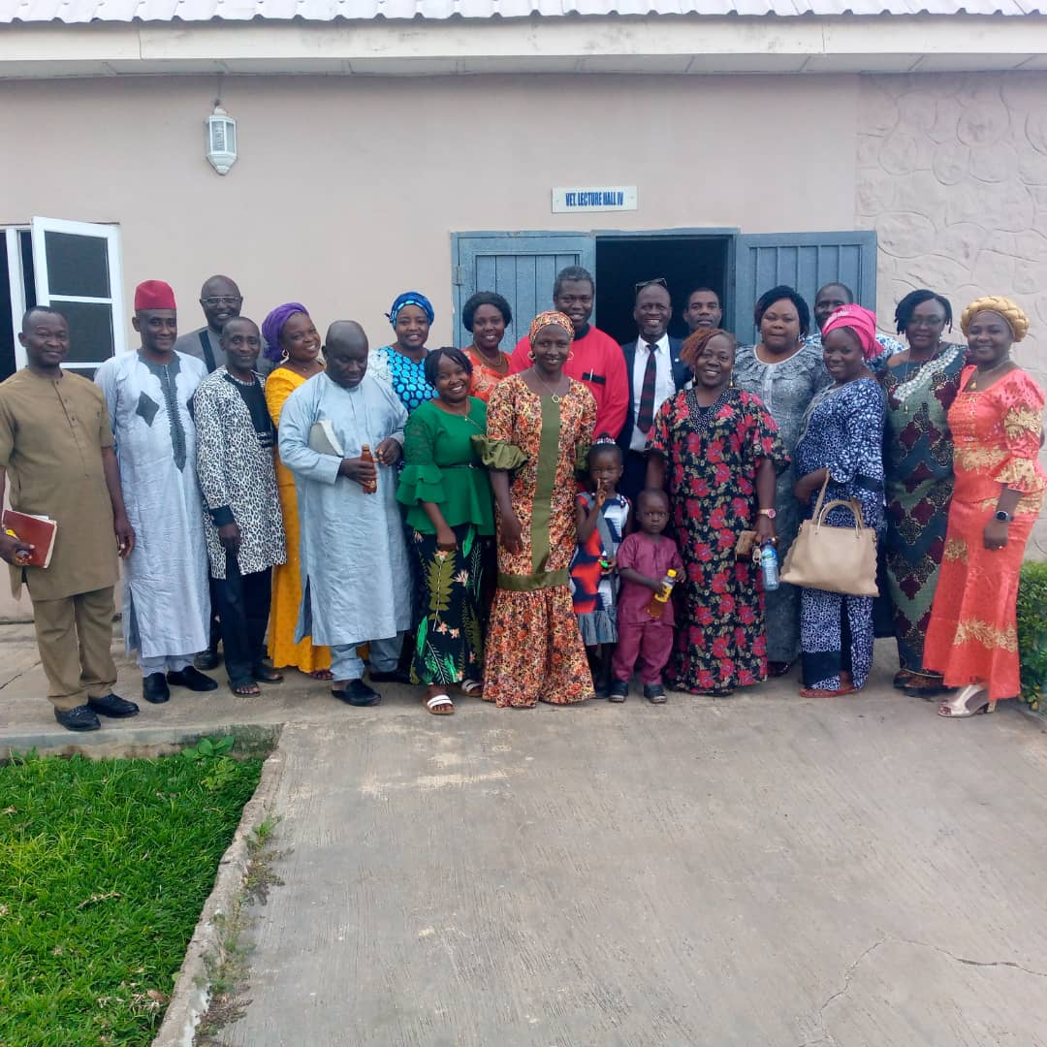
Fellowship without ceasing

Slide 33
His mother said to the servants, “Do whatever he tells you” John 2:5

